Slide 2
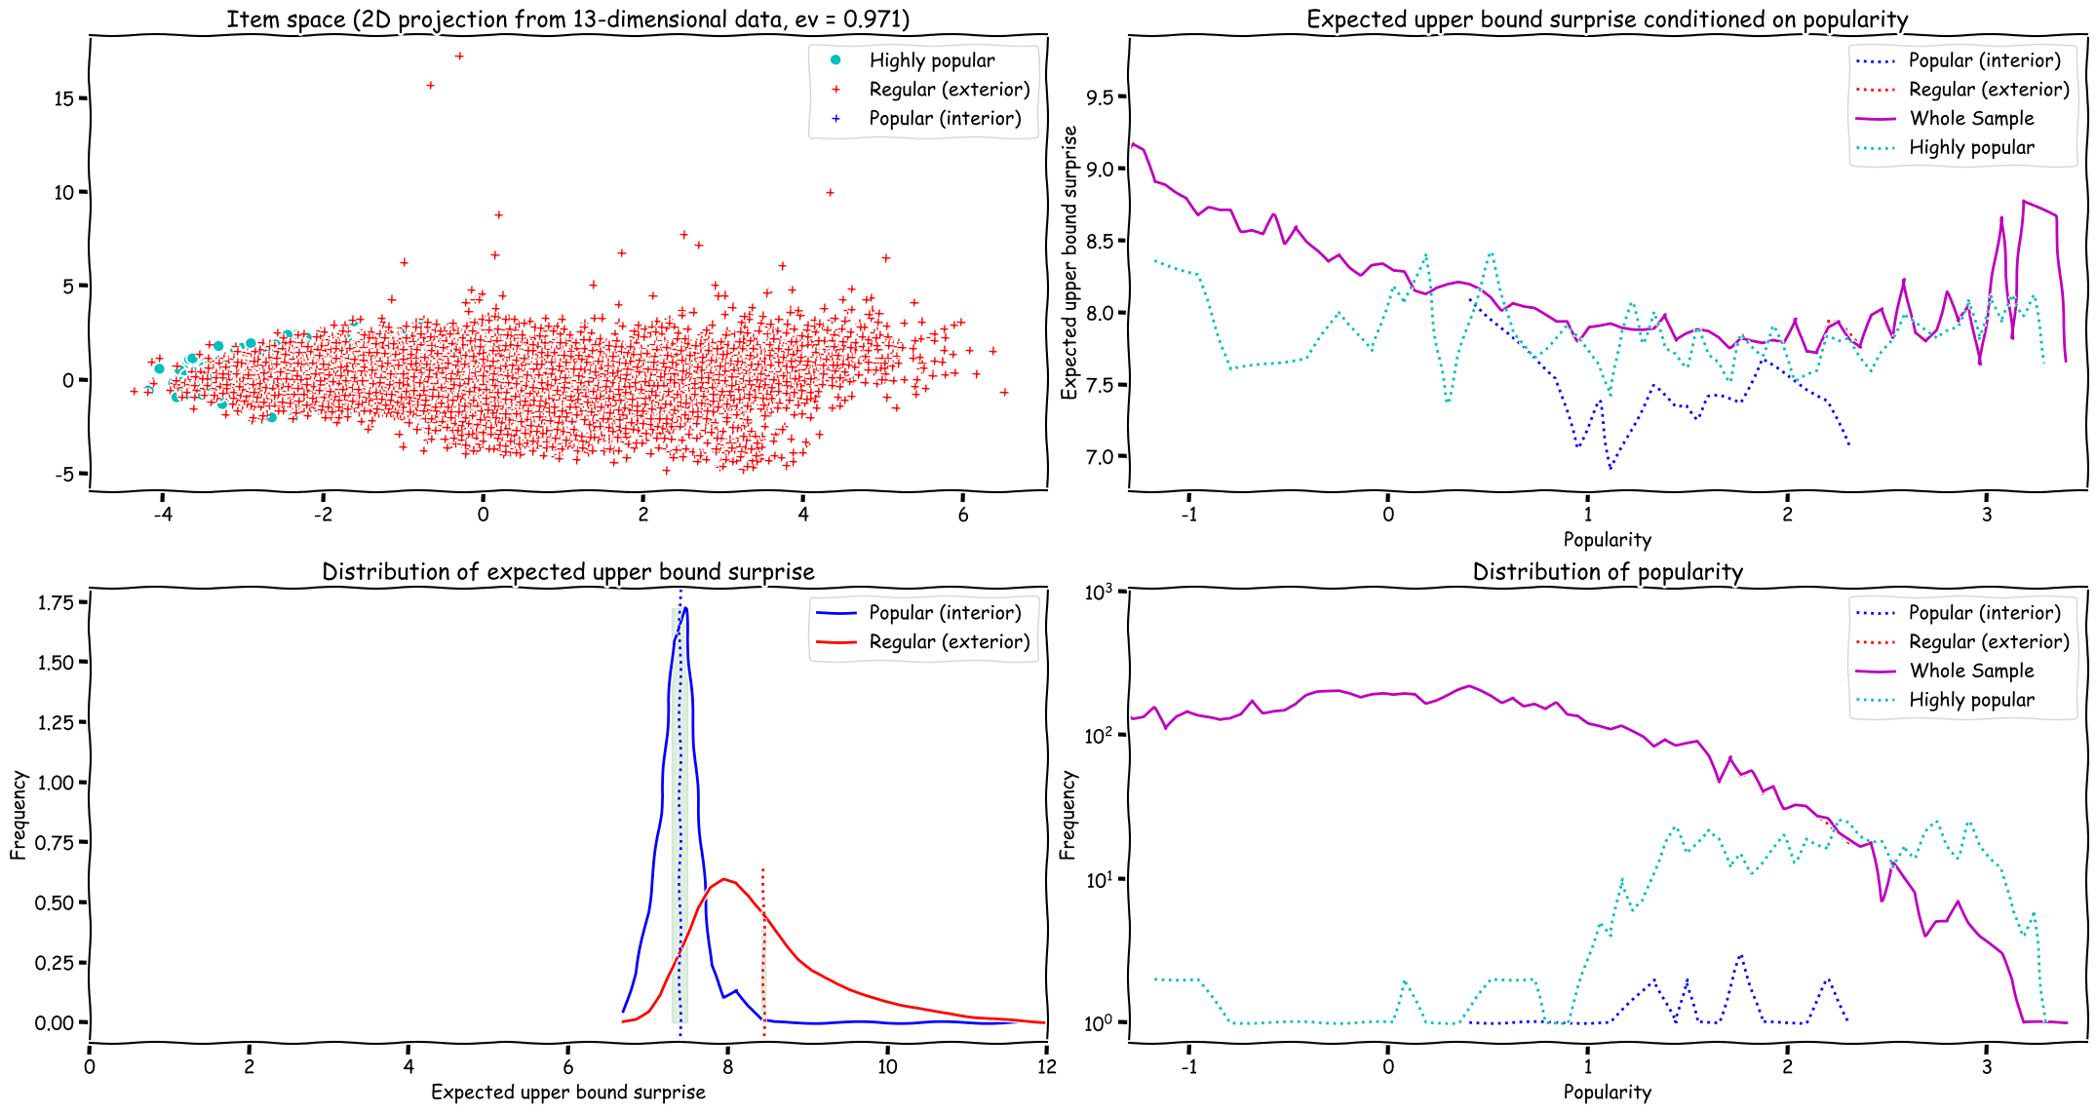
2
1
3
Notes:
1. Sample of highly popular items (obtained from Spotify’s Daily Song Rankings) include some items of low popularity (as informed in the other dataset, the Spotify’s Audio Track Features).
2. This seems a little bit counterintuitive: the variance of the expected upper bound surprise increases as popularity moves from 2 towards 3 SD.
3. I would expect this curve to resemble ‘Highly popular’; the fact it doesn’t signals that the hull may be a poor predictor of popularity.

Slide 3
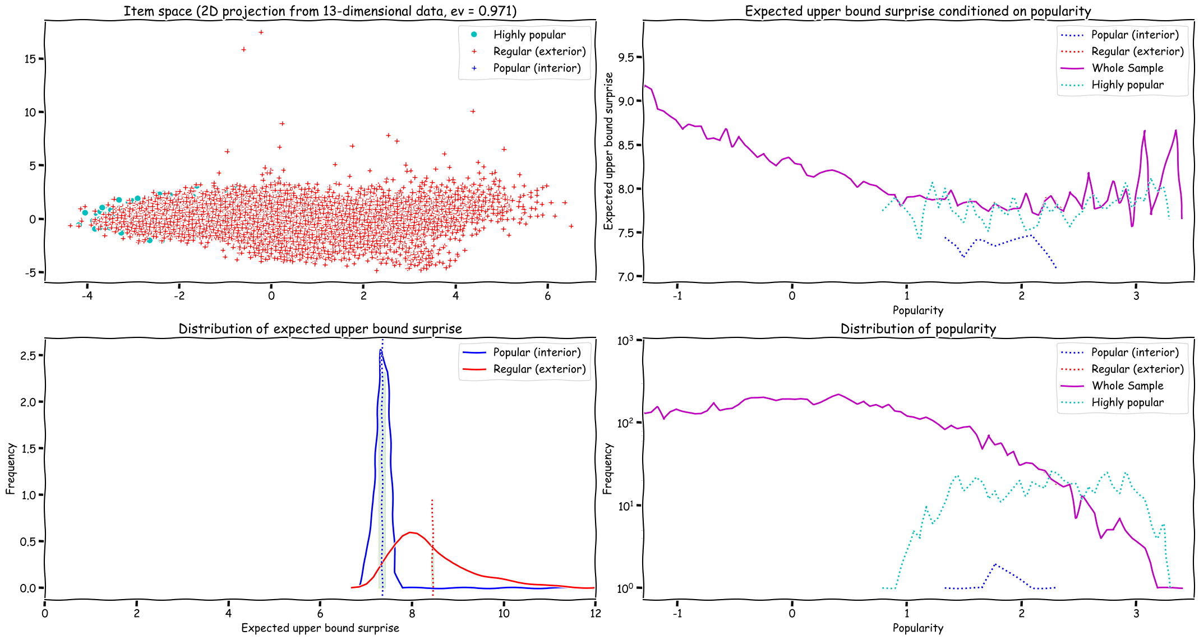
2
1
3

Slide 5
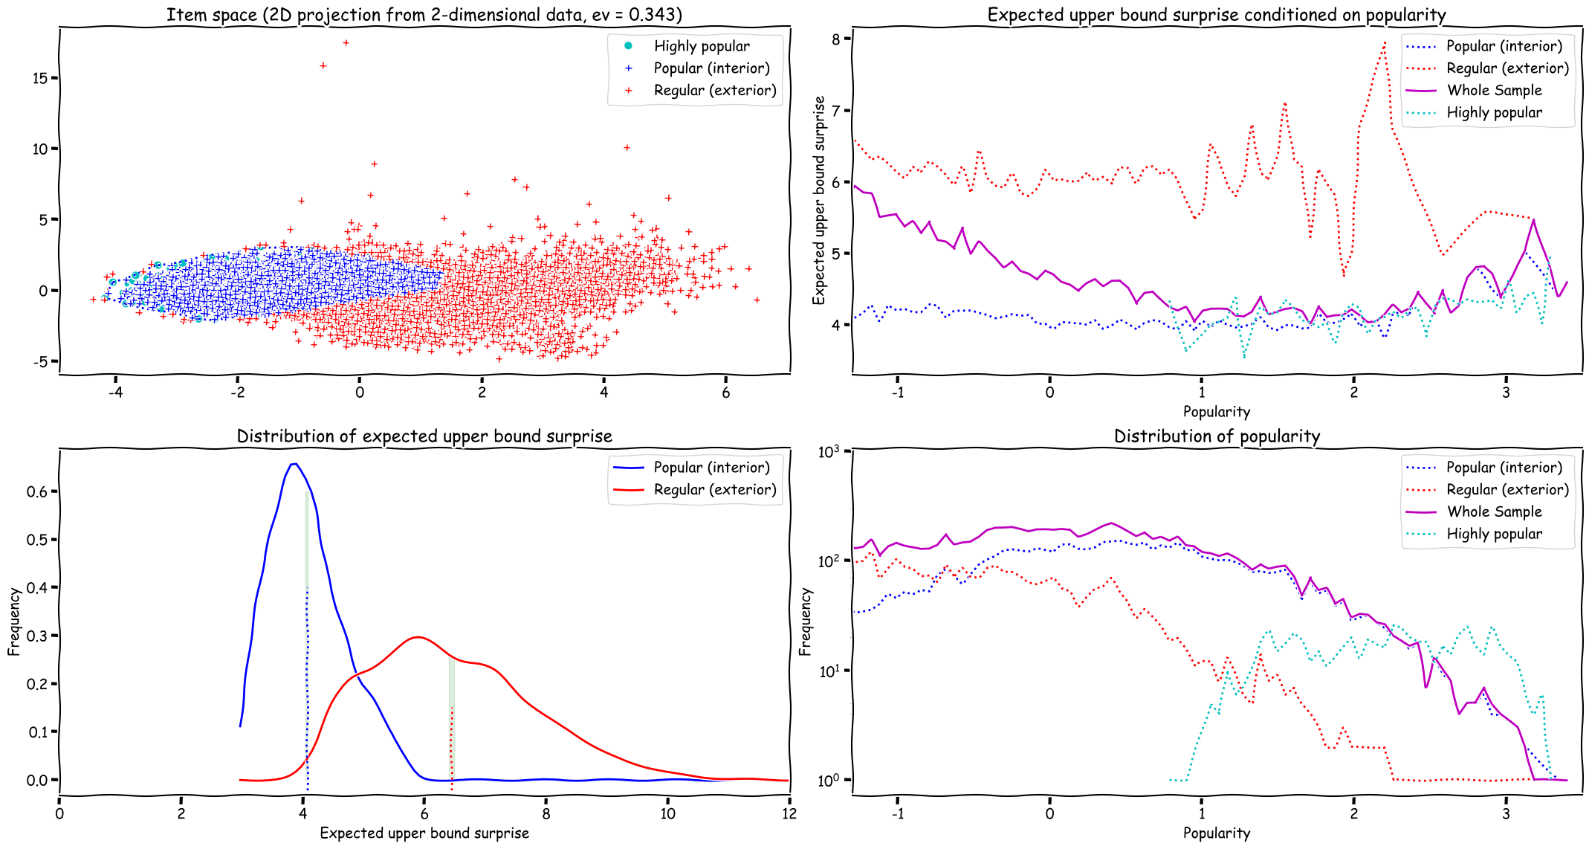
Notes:
epsilon = 1.0

Slide 6
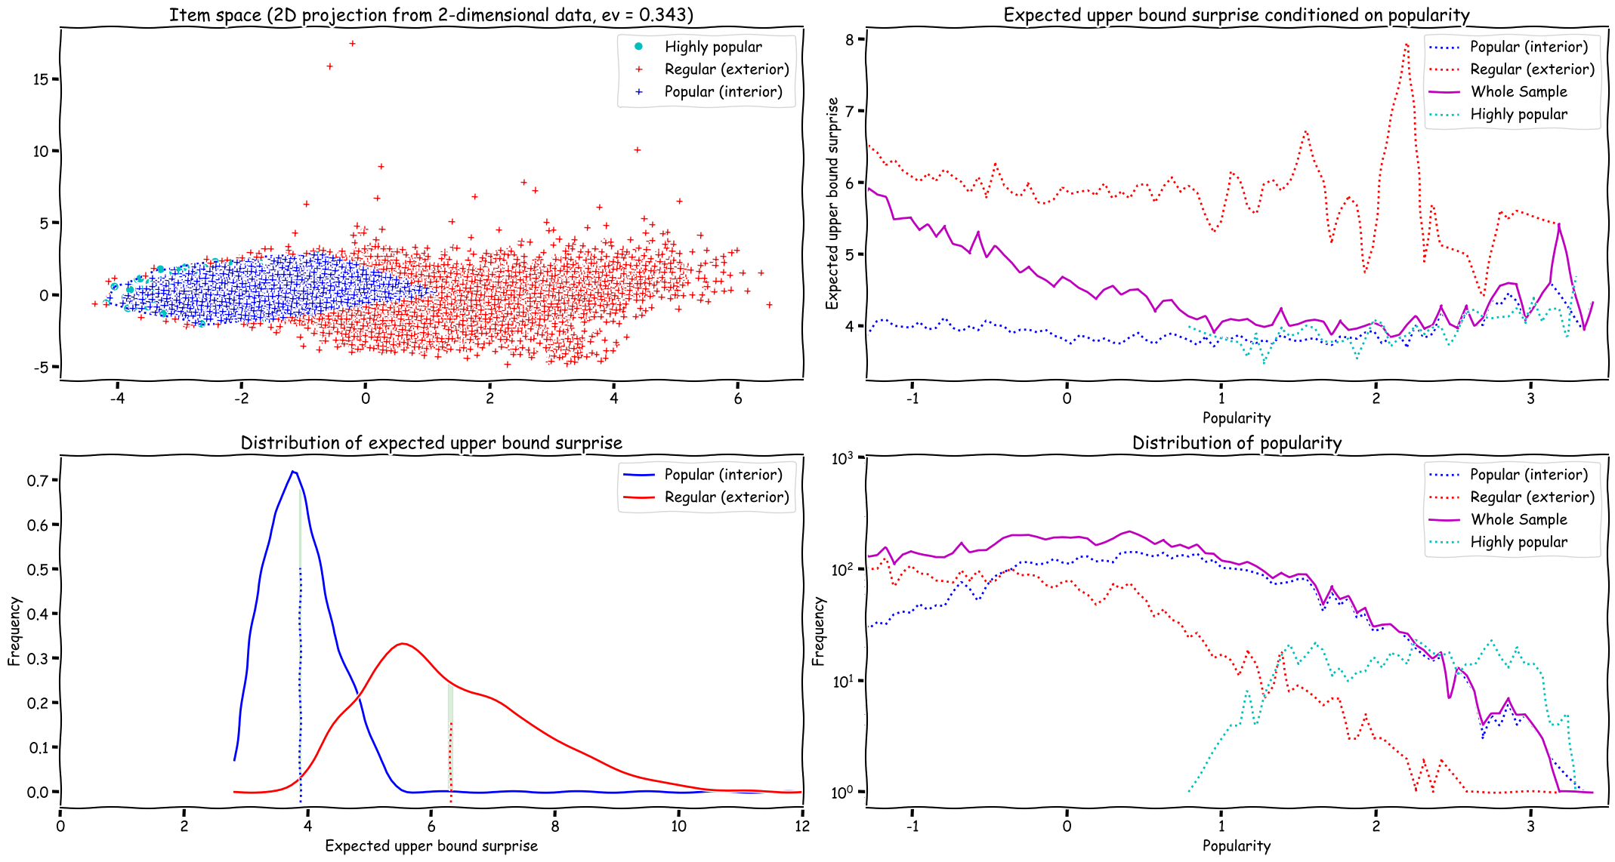
Notes:
epsilon = 0.9

Slide 7
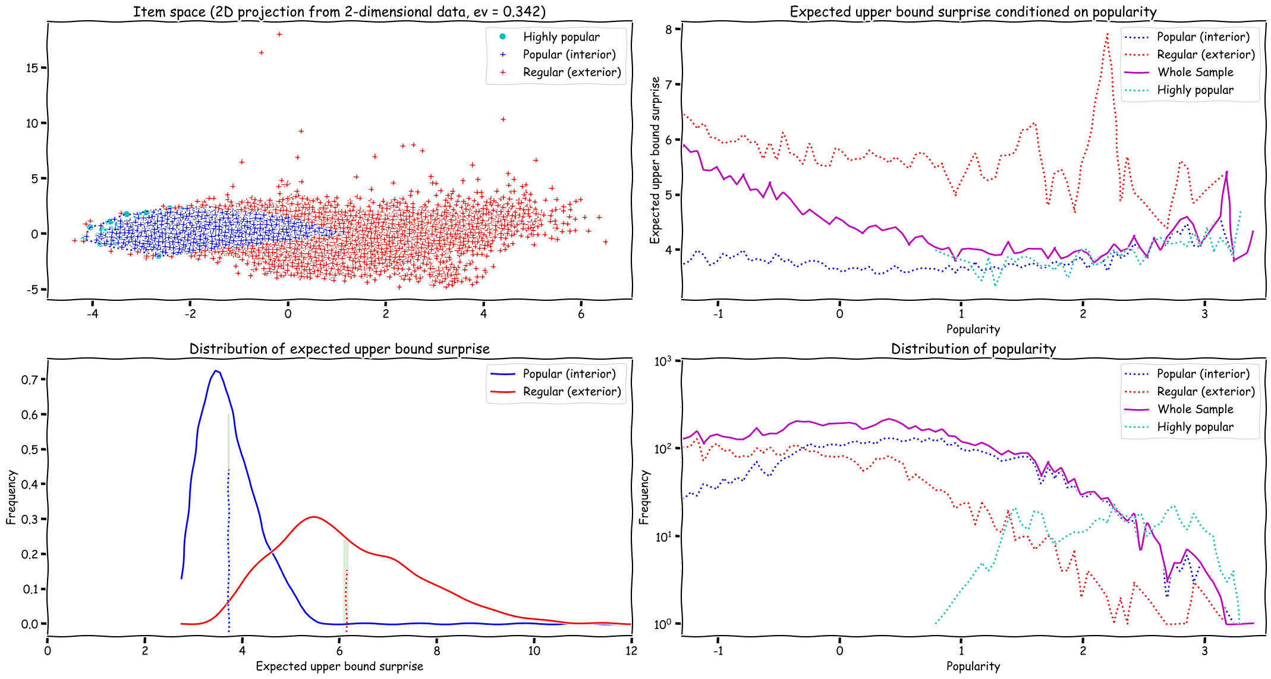
Notes:
epsilon = 0.8

Slide 8
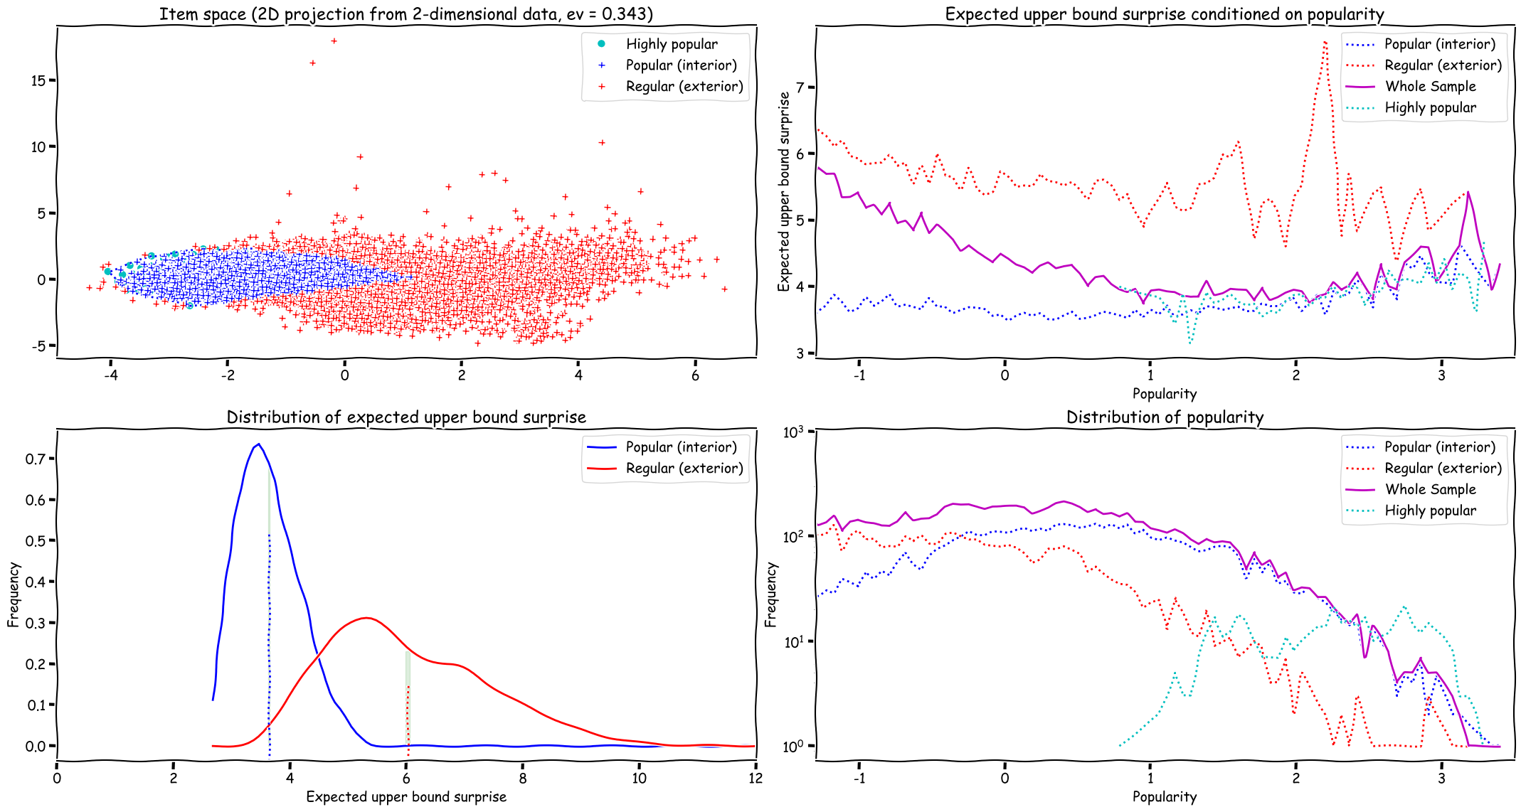
Notes:
epsilon = 0.7

Slide 9
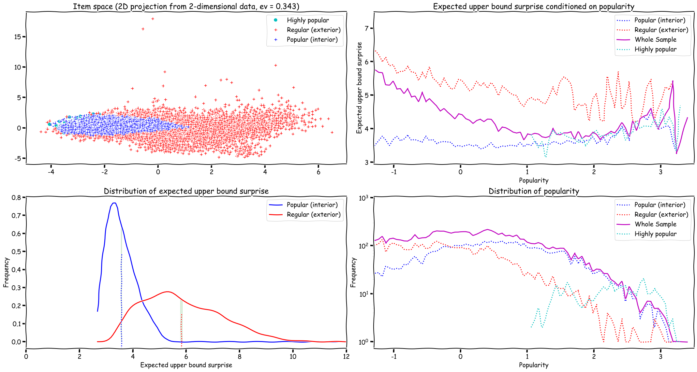
Notes:
epsilon = 0.6

Slide 10

Notes:
epsilon = 0.5

Slide 12
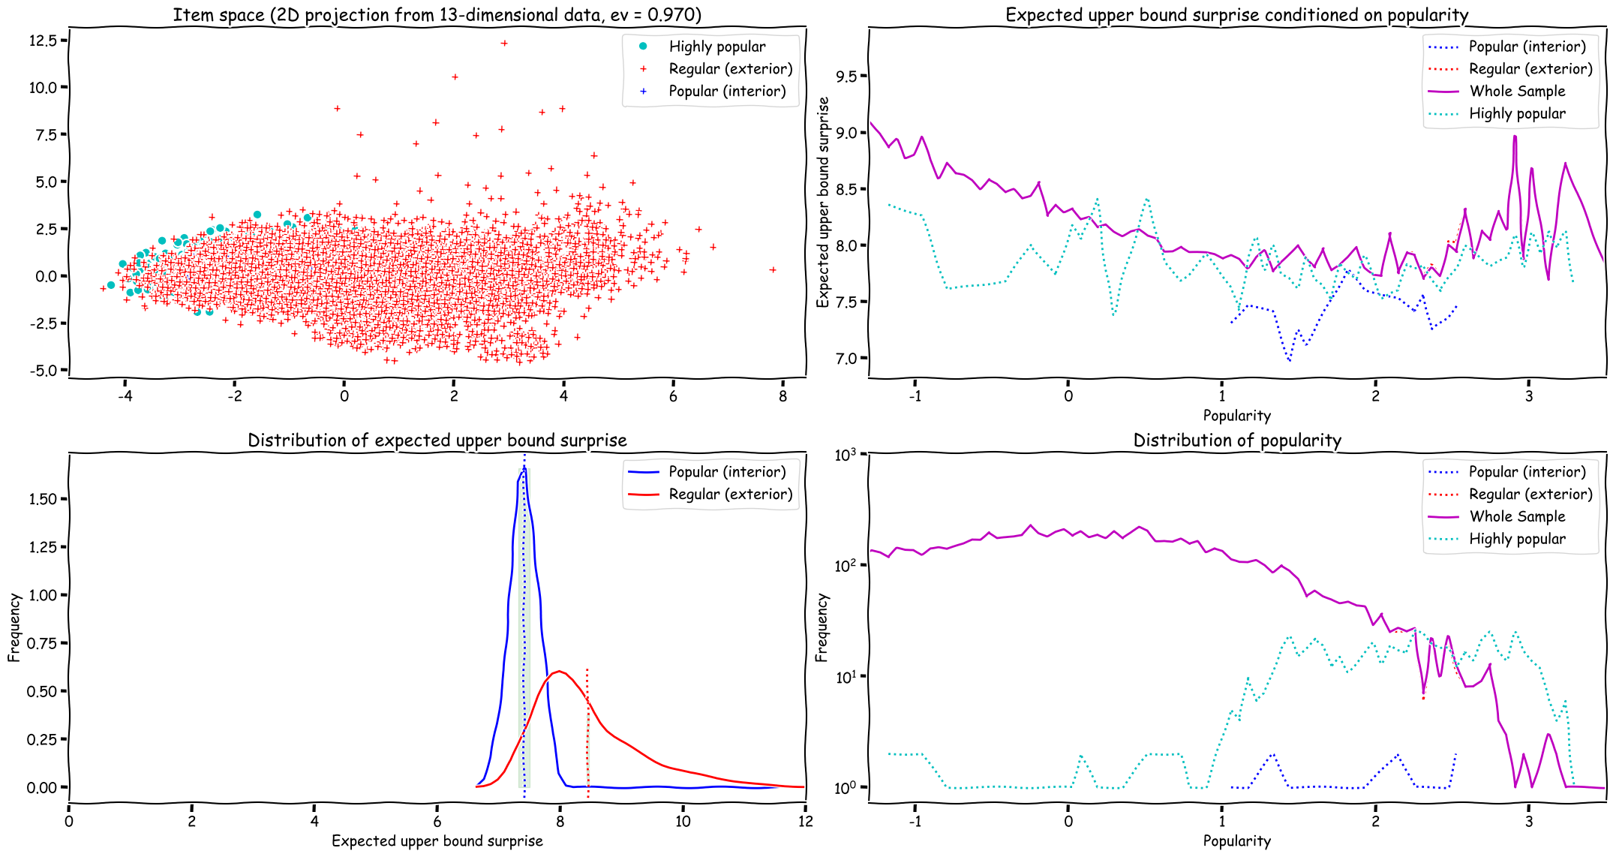
strongly agree
agree
neutral
disagree
strongly disagree

Slide 13
strongly agree
agree
neutral
disagree
strongly disagree

Slide 14
Fixed epsilon (1.0)
minimal popularity of 0.75 to be included in the Highly Popular sample

Slide 16
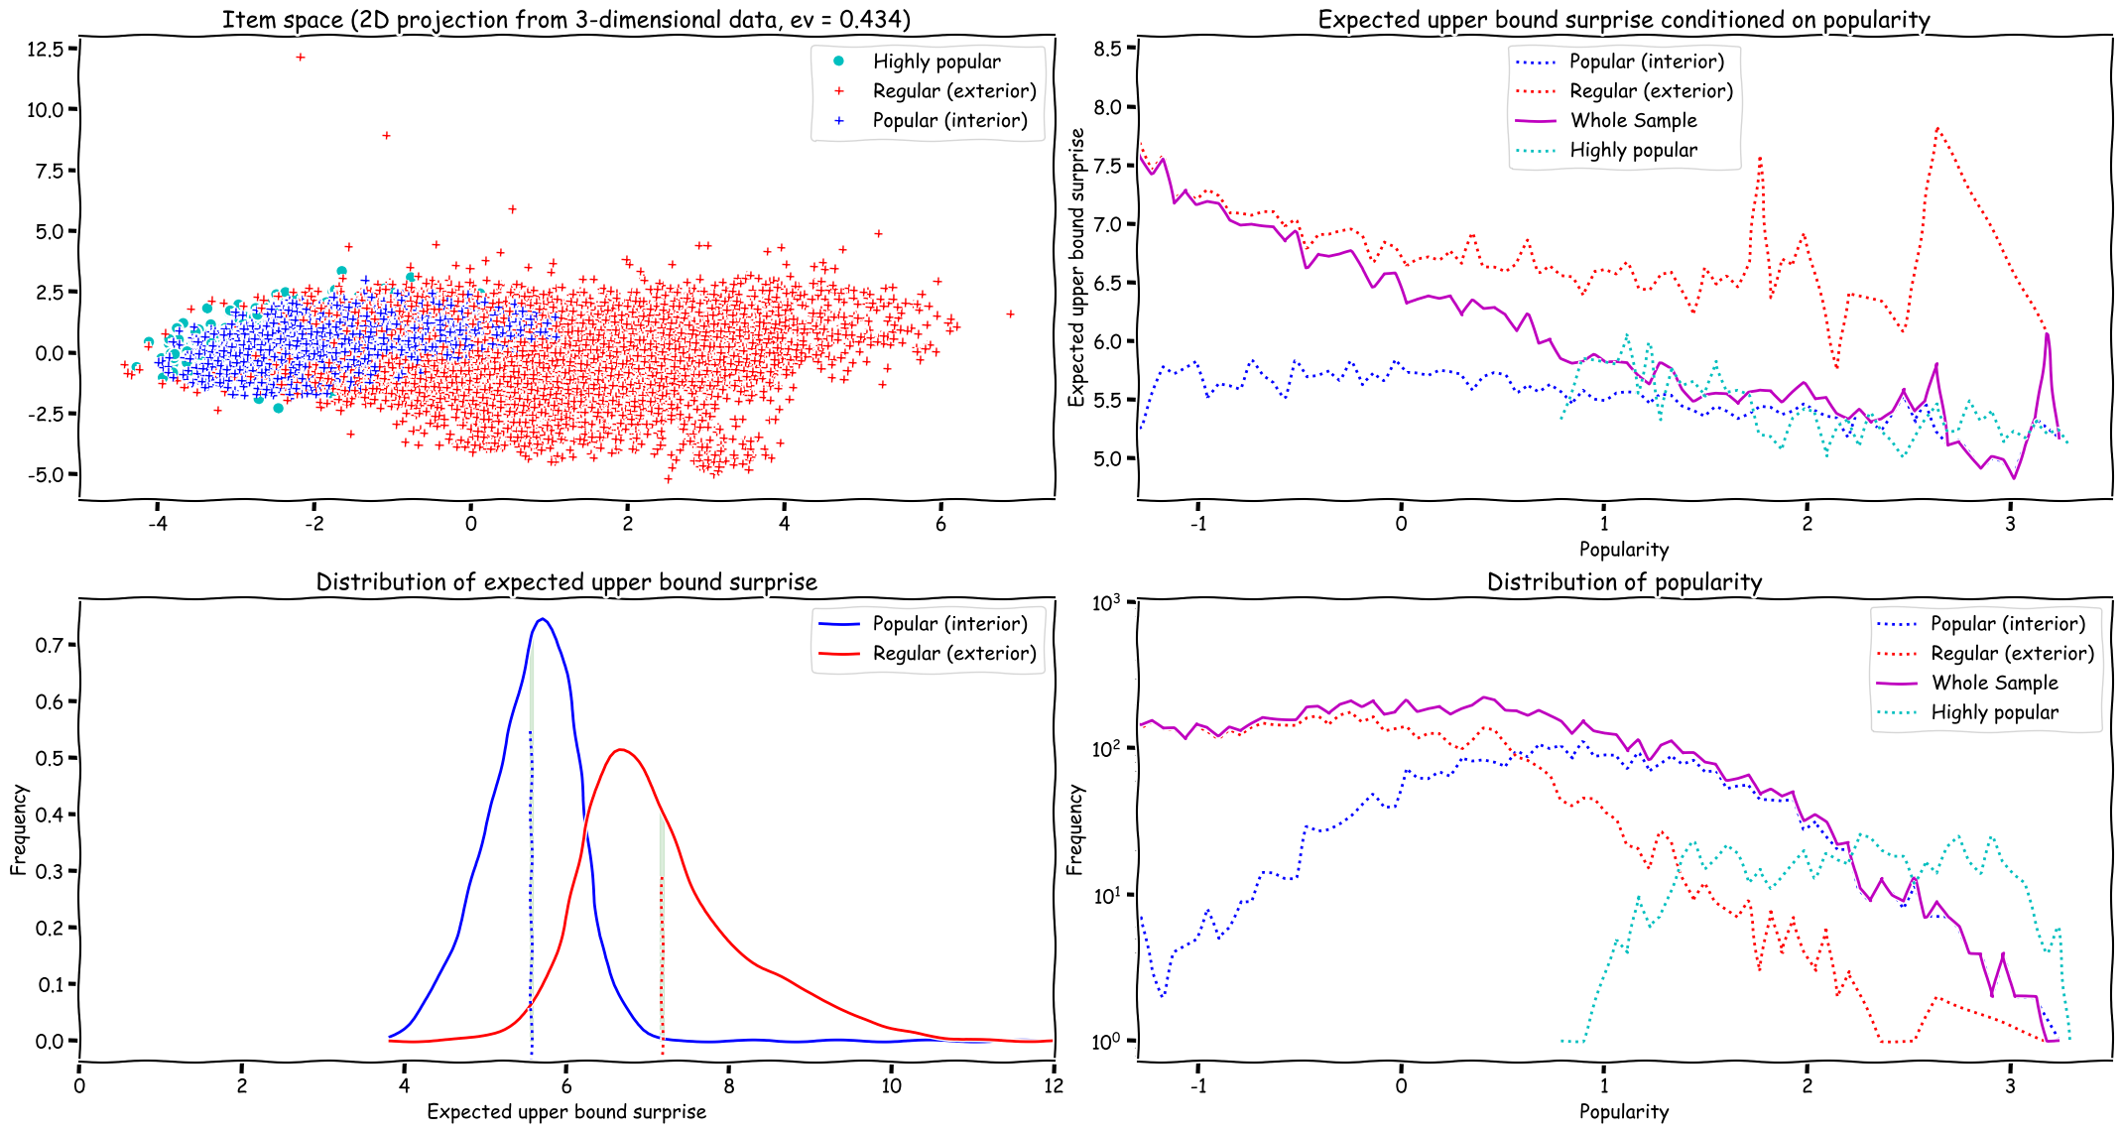

Slide 17
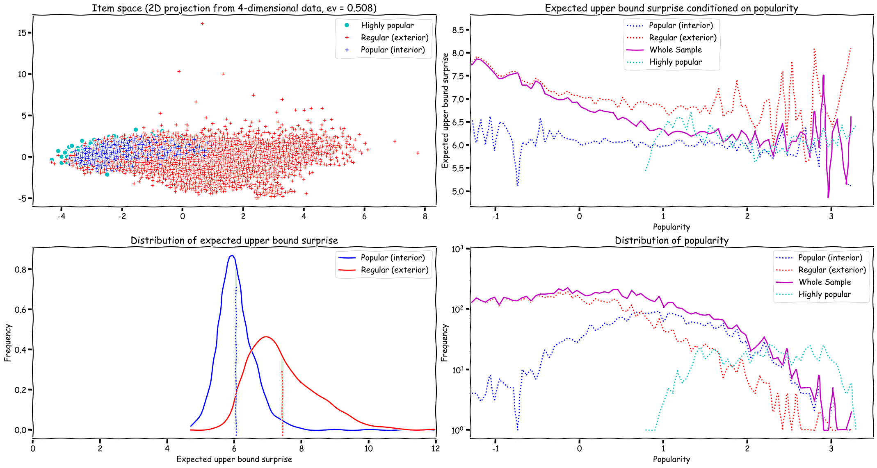

Slide 18
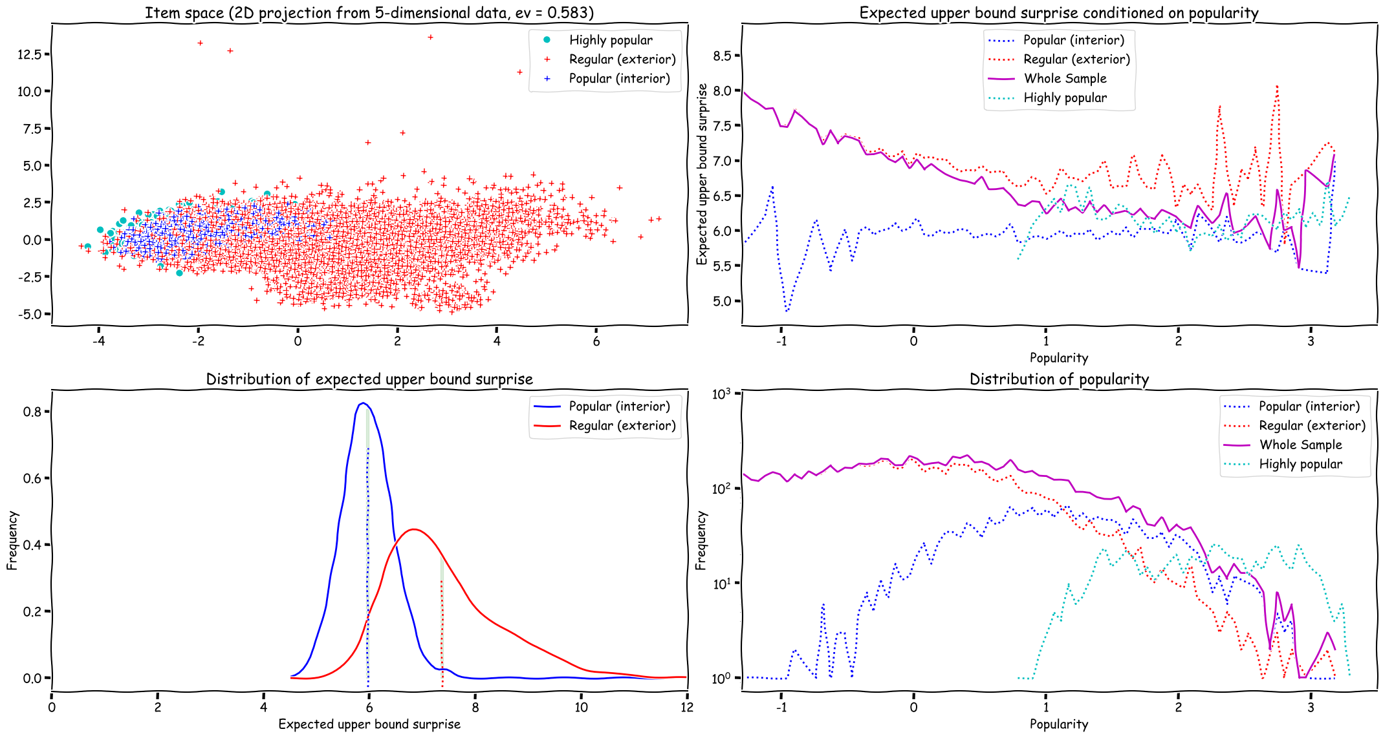

Slide 19
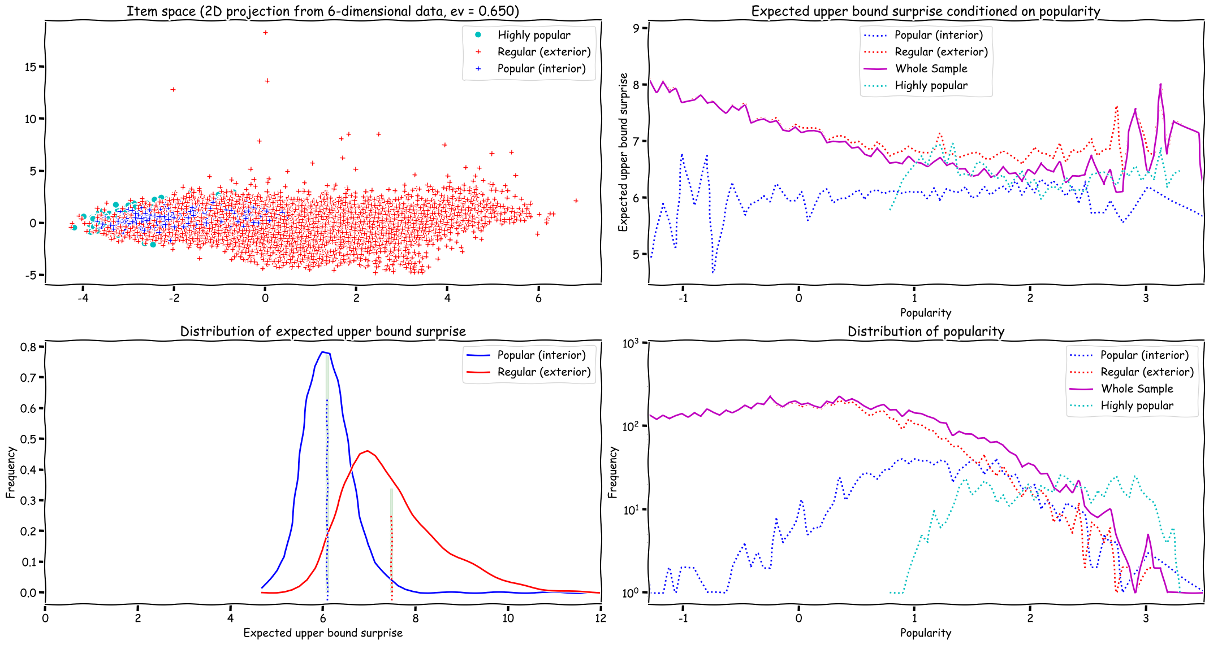

Slide 20
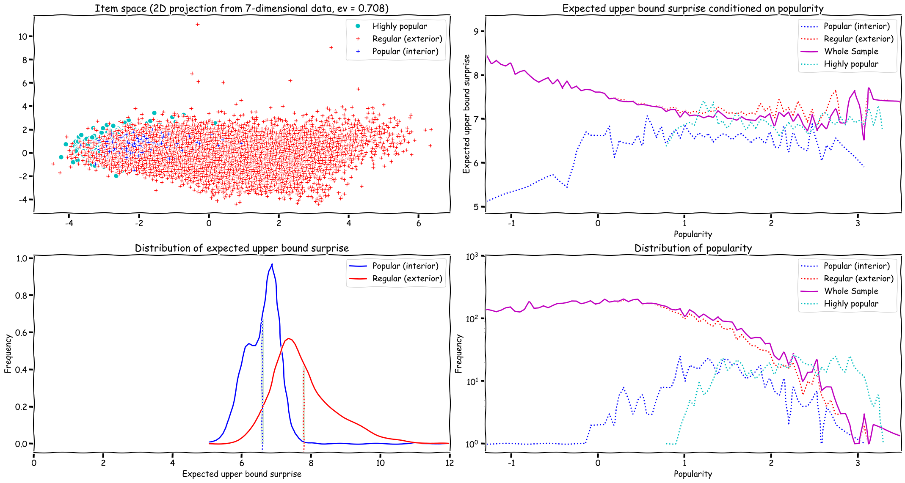

Slide 21
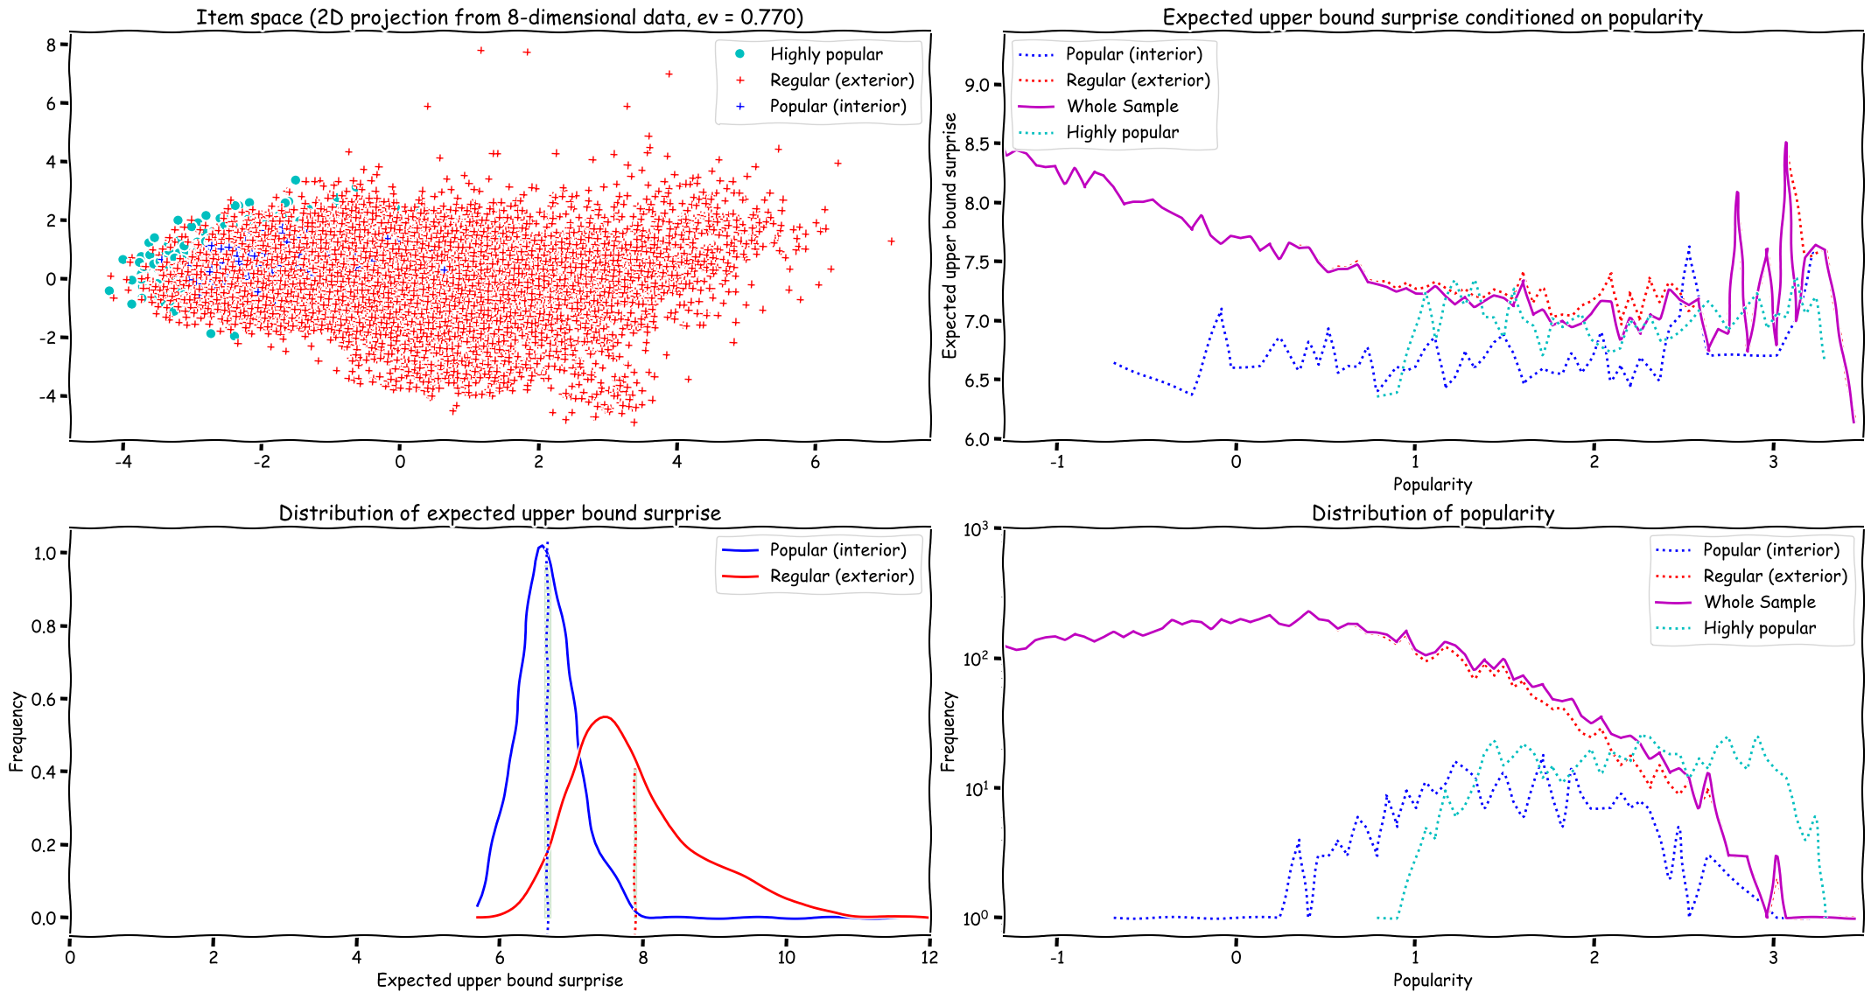

Slide 22
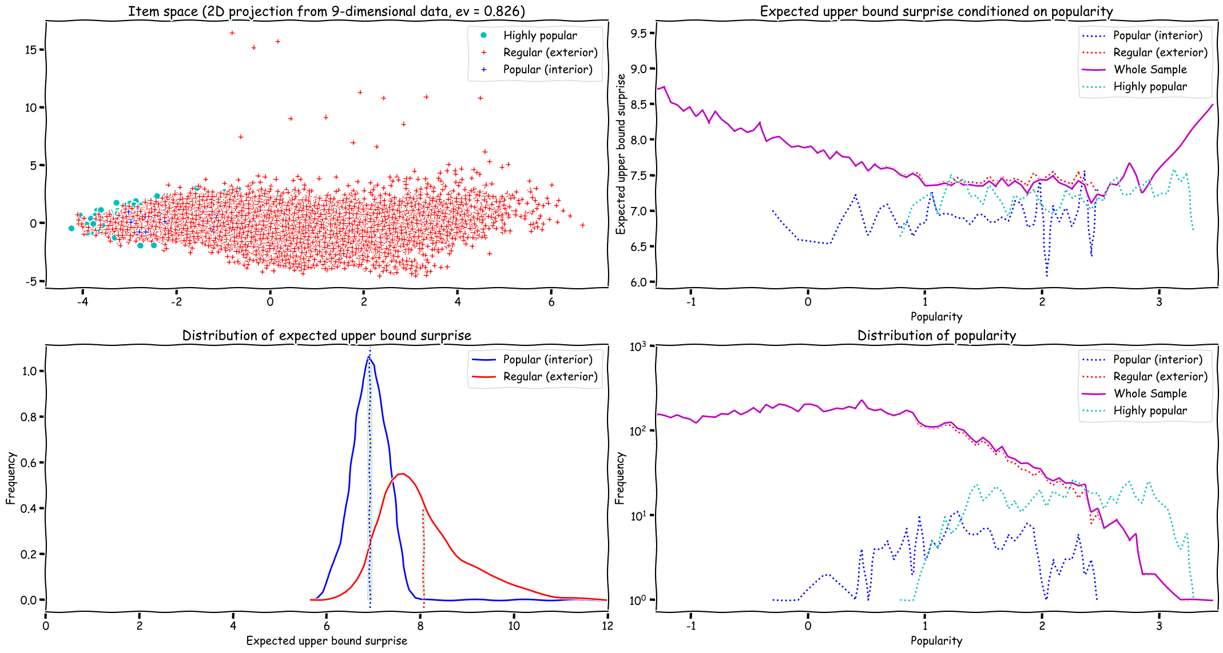

Slide 23
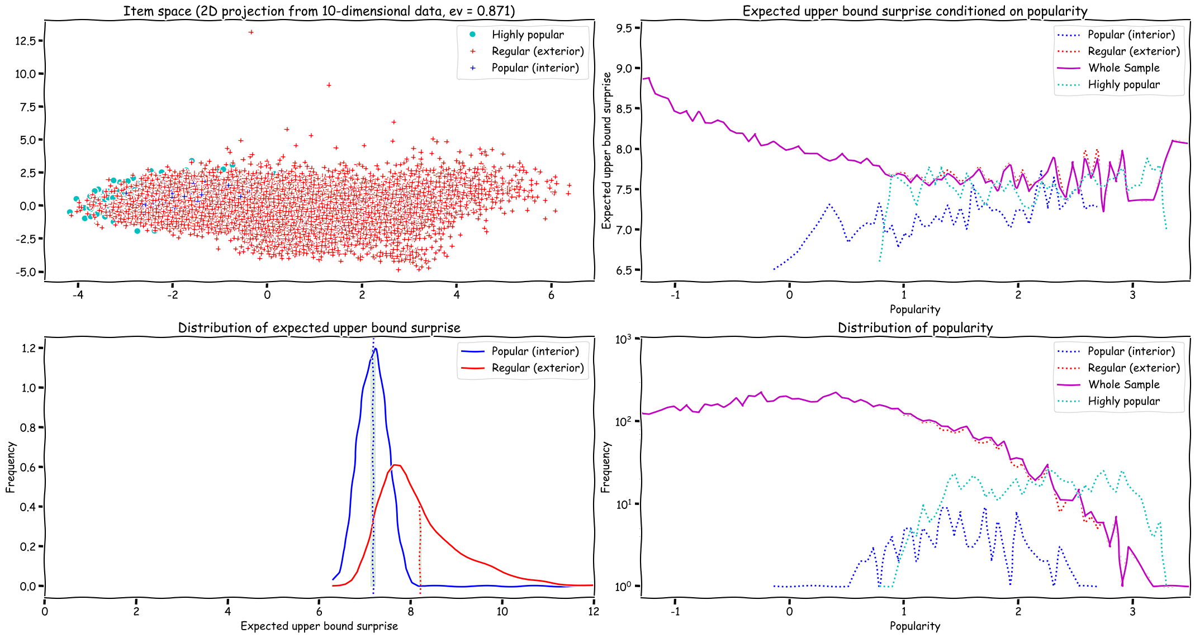

Slide 24
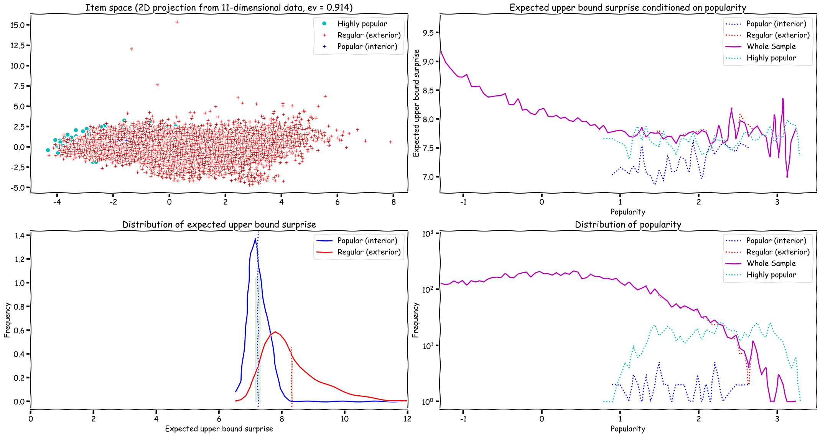

Slide 25
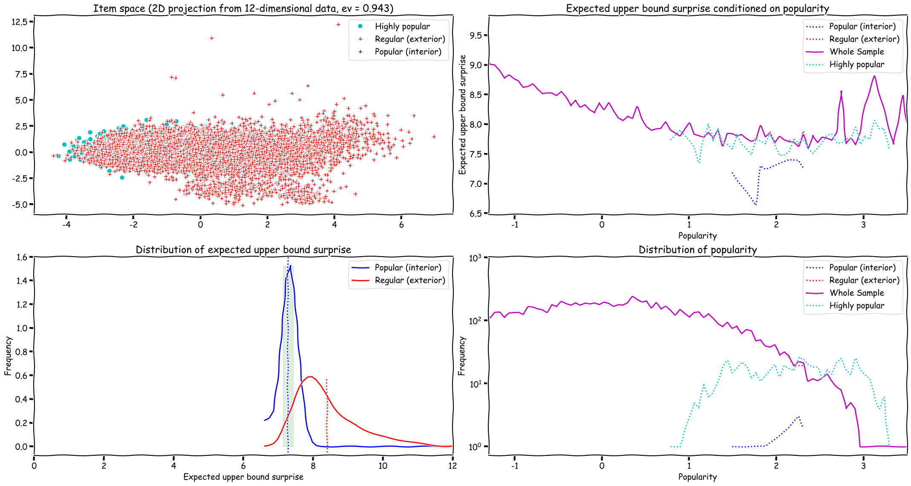

Slide 26


